Slide 1

Reverse hypothesis engineering ads
SURF EXCEL ADS
By
PRIYADHARSHINI M

Slide 2

SURF EXCEL
ADVERTISEMENT
Notes:
© Copyright Showeet.com – Free PowerPoint Templates

Slide 3
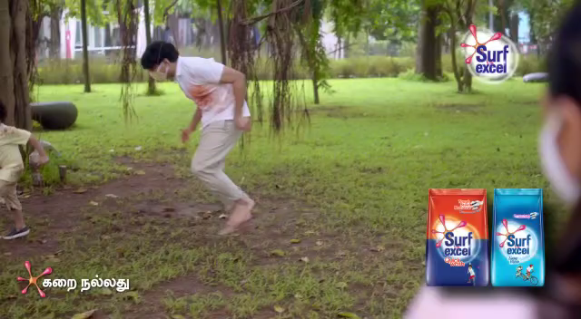
SURF EXCEL AD – DIRT IS GOOD

Slide 4

ADVERTISEMENT
CONCEPT
Notes:
© Copyright Showeet.com – Free PowerPoint Templates

Slide 5

The above ad is trying to commodify the need of clean clothes. The ad uses underlying psychology of add vitality to life to reach its consumers. This add is a very good example of how adding a little emotion and sentiment in ad making get viewers emotionally connected. The advertisement is based on sentimental values.

Slide 6
TARGET
The advertisement is defining and addressing household. The advertisement mainly focuses on house wives having kids and who have the necessity of cleaning clothes 3-5 times in a week as the target group. The advertisement target the children through tagline dirt is good. This was done keeping in mind that a major part of dirty laundry comprises of children clothes. This ad says that you go play in dirt and we will be there to take care of the stains. This advertisement also focuses on the fact that the children are innocent, they do commit many mistakes but those mistakes are how they learn. The advertisement also focus on giving out the message that person grows with an experience.

Slide 7

REVERSE HYPOTHESIS ANALYSIS
Generally the character which is shown in the Television, Social media, Newspaper about the advertisement is based on the majority or minority of that character purchasing the products.
In the above advertisement their main target is to attract the mother who have children.
So here we are going to discuss
why they have selected mother with children?
What is the main reason for that?
Notes:
© Copyright Showeet.com – Free PowerPoint Templates

Slide 8
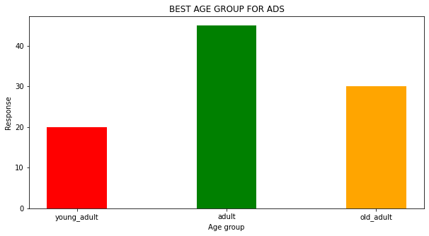
HYPOTHESIS TEST
ANALYSIS
GRAPH
Here I have selected 3 age groups. There are young adult, Adult, and Old adult. Young adult are age group who are in the age of 15-20 that means they are studying school or college. Adult are age group who are in the age of 20-30 that means they are working or may be married and have children. Old adult are age group who are in the age of above 30 that means they are working and they have adult kids.
Here Adult is the one who have more majority, So they select Adult group to done the advertisement. To add the little more emotion they have selected the children in their advertisement.

Slide 9
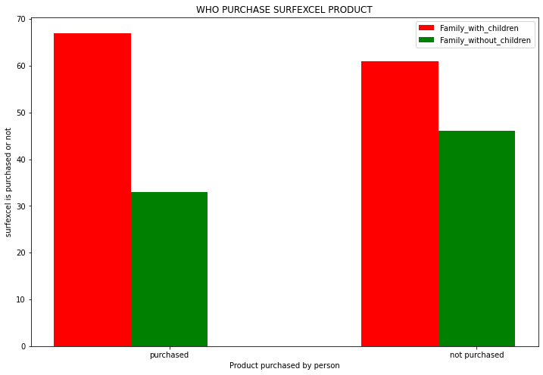
HYPOTHESIS TEST
ANALYSIS
ANALYSIS
GRAPH
As per their advertisement only the family who have children are purchasing the surf excel
Is their target is correct or not?, Let’s check
There is no difference between Family with children and Family without children purchasing the surf excel
Though family with children are purchasing the surf excel but we cannot say all the family with children are only purchasing surf excel.
Family who don’t have children also purchasing the surf excel because of the brand, quality, quantity, fragrance, package, price.
Any way their advertisement reach to attract the family with children is well and good.

Slide 10
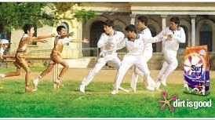
Large Image slide
Notes:
© Copyright Showeet.com – Free PowerPoint Templates

Slide 11

THANK YOU

